Slide 1
Report
Image Captioning Using Recurrent Neural Networks (RNNs)
Master: Quach Dinh Hoang
Tran Nguyen Thai Bao 19133010
Dinh Quoc Hung 19133025

Slide 2
Introduce about Image Captioning
Image Captioning is the task of automatically generating a description for an image. This task combines computer vision and natural language processing to create an automatic description for an image.
One of the most interesting problems in computer vision, with the goal of creating models and algorithms for computers capable of automatically generating a description (caption) for an input image.
Image captioning models achieve impressive results, and can be applied in many fields such as automatically creating captions for images, processing medical images and pharmaceuticals, and create diverse video games.

Slide 3
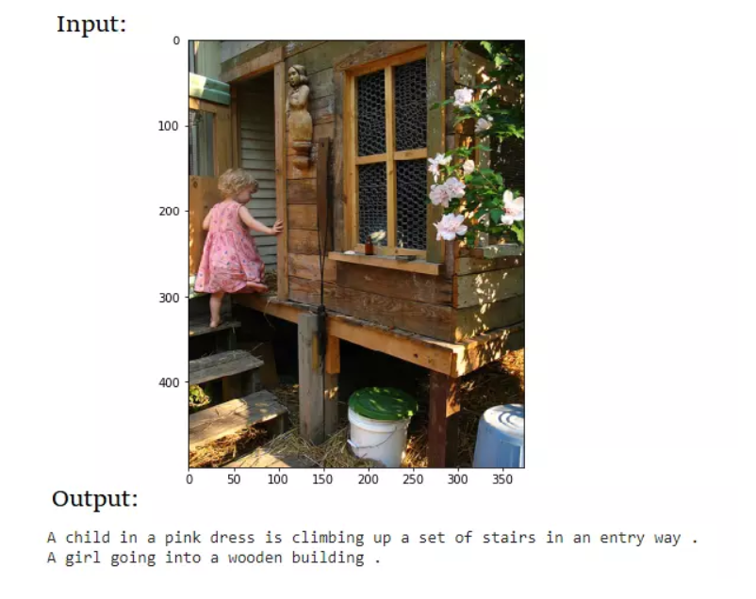
Image Captioning

Slide 4
Brief history about Image Captioning
2014: "Deep Visual-Semantic Alignments for Generating Image Descriptions" appeared. by Vinyals and colleagues at Google.
2015: Karpathy and Li of Stanford University proposed the model "Deep Visual-Semantic Alignments for Generating Image Descriptions with Human Parity" with an accuracy approximately equal to human semantics.
2016: Google released the dataset "Google Conceptual Captions" to train image captioning models with higher complexity
Now: The problem of creating image captions has grown significantly over the years and is currently one of the research areas of great interest in the artificial intelligence community.

Slide 5
Motivation
Potential applications in various fields, including assistive technologies for the visually impaired, image and video search engines, and social media analysis.
Research on knowledge related to image captioning

Slide 6
Fundamental Knowledge
- Vision computer
- Convolutional Neural Networks (CNNs)
- Recurrent Neural Networks (RNNs)
- Evaluation Metric
- Dataset

Slide 7
Vision Computer
Computer vision is a multidisciplinary field that allows systems and computers to derive useful information from video, digital images, and other visual input formats.
Computer Vision is a rapidly growing field with numerous applications and opportunities for research and development.
A field of study focused on enabling computers to interpret and understand visual information from the world
The advancements in deep learning and big data are fueling new breakthroughs and innovation in this field.

Slide 8
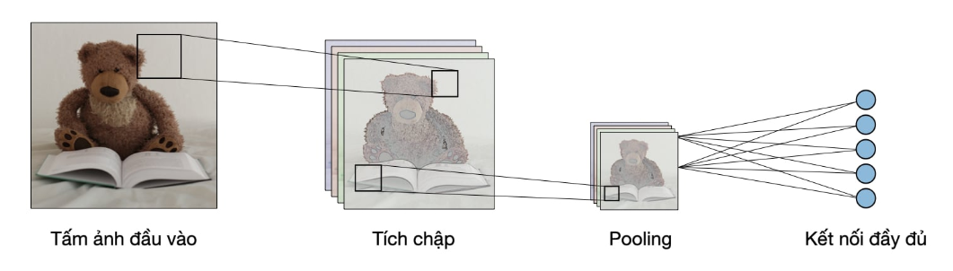
Convolution Neural Network
CNNs are a type of deep neural network used in computer vision tasks
Designed to automatically and adaptively learn spatial hierarchies of features from input images.
CNNs consist of multiple layers: convolutional layers, pooling layers, and fully connected layers
Nguồn: Đại học Stanford

Slide 9
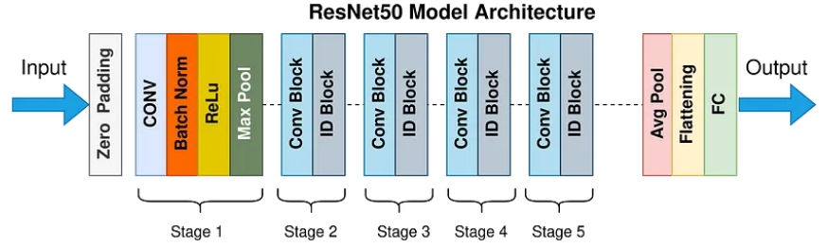
Convolutional Neural Networks (CNNs)
Architecture model resnet 50

Slide 10

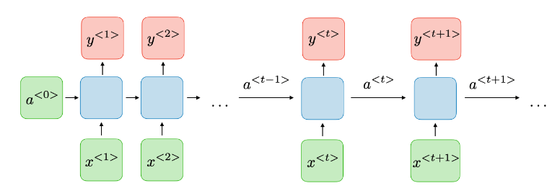
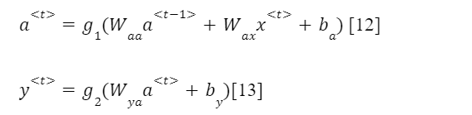
Recurrent Neural Networks (RNNs)

Slide 11
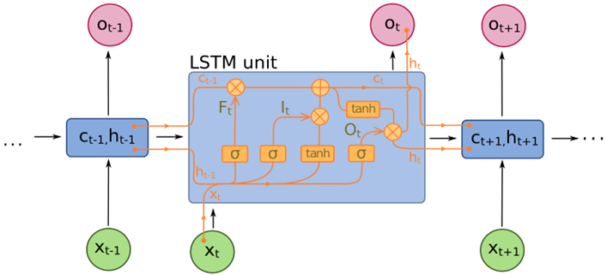
Recurrent Neural Networks (RNNs)
LSTM

Slide 12
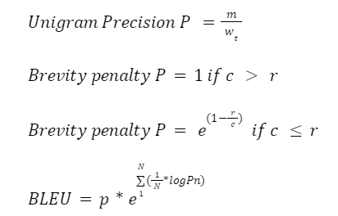
Evaluation Metrics
BLEU

Slide 13
Empirical Study
Prepare Dataset: Flickr8k dataset
Data preprocessing
Use Resnet50 models for feature extraction
Use Long Short-Term Memory to create image captions
Train model
Evaluation model: use evaluation metrics BLEU
Demo on flask app

Slide 14
Flickr8k Dataset
The Flickr8k dataset was created by a team of researchers in the fields of natural language processing and computer vision. The study was published in 2011 and titled "Building a Large-Scale Dataset for Image Annotation, Captions and Retrieval"
The purpose of the Flickr8k dataset is to provide a diverse and rich dataset for research and development of natural language and image processing models.
The dataset consists of 8091 images, with 5 descriptions corresponding to each image.

Slide 15
Data Preprocessing
Language preprocessing: + Text normalization + Vocabulary construction + Prepare input data for the model + Padding and input formatting
Image preprocessing: + Image Resizing + Feature extraction + Pooling to Reduce Size + Feature Normalization + Padding

Slide 16
Use Resnet50 models for feature extraction
Load a pre-trained ResNet model
Preprocessing image
Passing images through the model
Using feature extraction

Slide 17
Use Long Short-Term Memory to create image captions
Image preprocessing
Language preprocessing

Slide 18
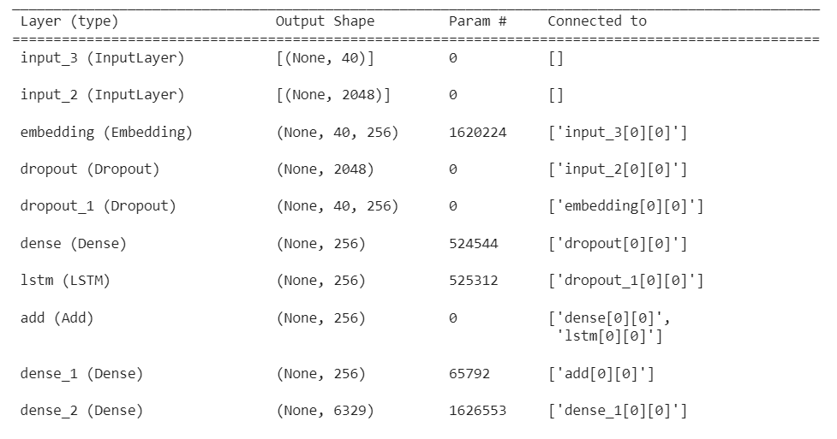
Train Model
Input: Feature image and encoded captions

Slide 19
Train Model
Select hyperparameter
Learning rate: 0.0001
Batch size: 3 5
Step: 1200
Epochs: 3 5
Best hyperparameter
Learning rate: 0.0001
Batch size: 5
Step: 1200
Epochs: 5

Slide 20
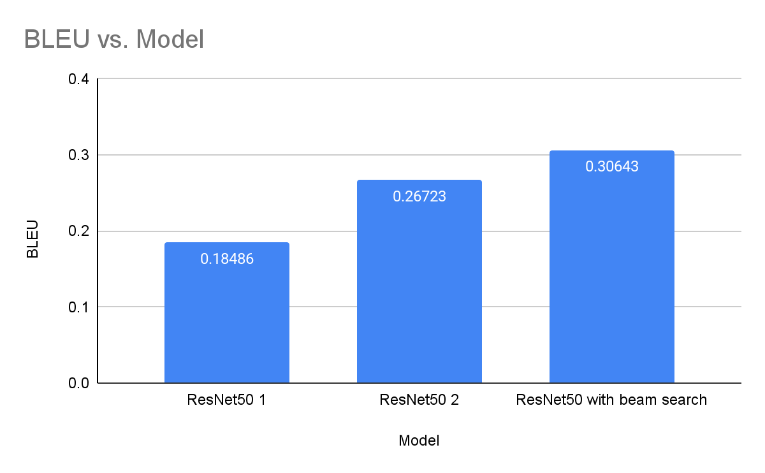
Evaluation model

Slide 21
Limitations
Image processing
Small Dataset
Model's depth
Complexity and computational cost

Slide 22
Development directions
Use dataset with larger size
Use models with more complex depth
Expand the Flickr8k dataset or collect new datasets with more detailed taxonomy, a greater variety of visual content and linguistic descriptions
Using Ensemble Learning
Notes:
Sử dụng tập dữ liệu có kích thước lớn hơn tập dữ liệu như: Flickr30k, Coco,...
Sử dụng mô hình có độ sâu phức tạp hơn nhằm mục đích tăng độ chính xác khi đưa ra giá trị dự đoán.
Sử dụng Ensemble Learning: Kết hợp nhiều mô hình Image Captioning khác nhau để tạo ra mô hình Ensemble có khả năng tạo ra các mô tả hình ảnh đa dạng và chất lượng cao hơn. Ensemble Learning có thể giúp cải thiện độ chính xác và tính đa dạng của các mô hình Image Captioning.
Tạo ra các bộ dữ liệu mới và phong phú hơn: Mở rộng tập dữ liệu Flickr8k hoặc thu thập các tập dữ liệu mới có độ phân loại chi tiết hơn, đa dạng hơn về nội dung hình ảnh và mô tả ngôn ngữ. Điều này giúp tăng tính tổng quát hóa và khả năng áp dụng của mô hình Image Captioning..

Slide 23
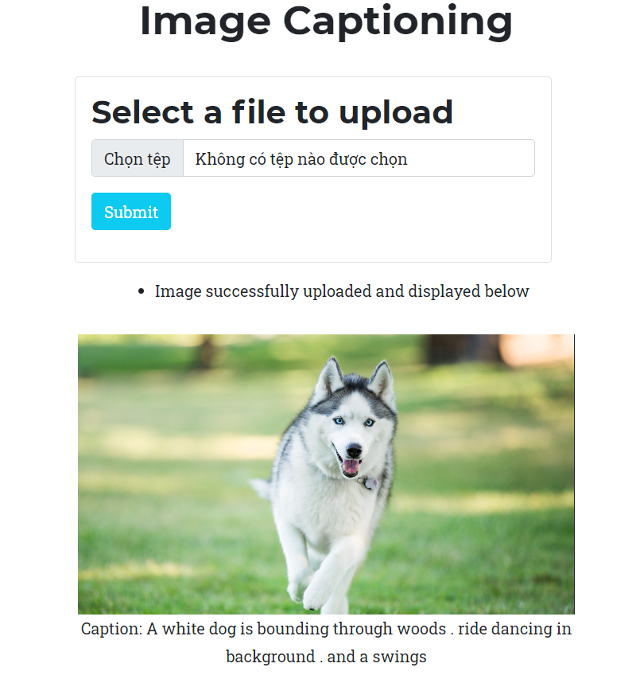
Demo On Flask App

Slide 24
THANK YOU FOR
LISTENING

